Slide 1
Generating an Optimal Path for Variable Joint Stiffness in an Underactuated System
Presented by: Satyam Bhawsinghka, Karina Puente, Lissette Wilhelm
Notes:
Lissette
Hello everyone! My name is Lissette Wilhelm and I am joined by Satyam and Karina. We are presenting on our research of the optimal path for variable joint stiffness in underactuated systems

Slide 2
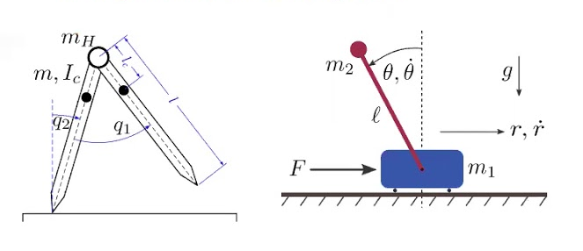
Underactuated Systems
What are they?
Actuated DOF < Total DOF of the system
Benefits
Light weight
More efficient
Low energy consumption
Coupled with compliant system they can help prevent damage
(Conference on Decision and Control, 2020)
Notes:
Lissette
So what are they?
Underactuated systems are systems that have fewer degrees of actuated freedom than of total degrees of freedom.
Underactuated systems are lighter weight, more efficient, consume less energy, and can prevent damage when coupled with compliant systems.
As you can see in the figure on the right, both systems have one actuated degree of freedom which is less than the system’s total 2 degrees of freedom
Motivation is provided for problem and related to realworld domains.
Argument for relevance to controls and/or robotics is strong

Slide 3
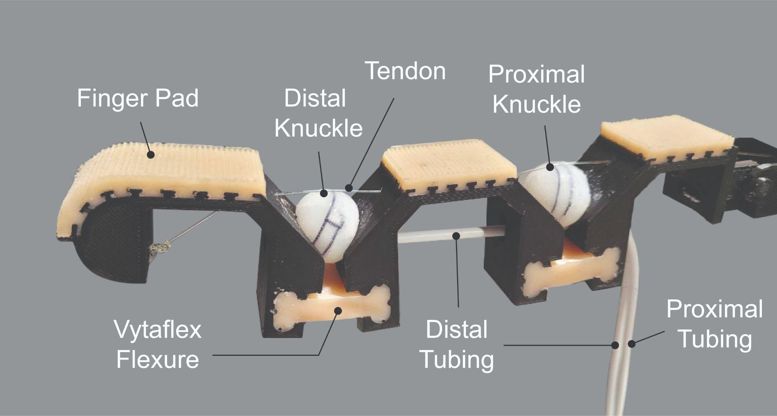
Underactuated Systems
Problem
No direct control over joint angles, so arbitrary trajectories in configuration space cannot be commanded.
Solution
Change stiffness of the joints along with tendon tension to achieve the configuration.
Notes:
Lissette
These systems lack direct control over the joint angles which can’t create arbitrary trajectories in the configuration space
Underactuated systems can allow control over desired positions by changing the joint stiffness.
This is a real world example of an underactuated system. The distal knuckles are hydraulic and can inflated and deflated to change the stiffness.

Slide 4
Related Work
Underactuated
Variable Stiffness
Knees
Ankles
Fingers

Slide 5
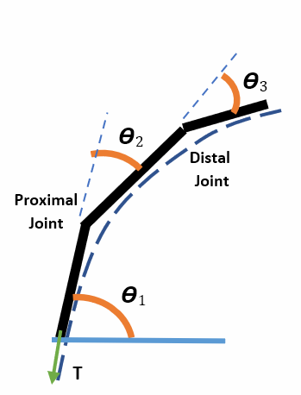
Problem Statement
The aim is to achieve a desired configuration of the system by generating an optimal path for discrete step wise control of joint stiffnesses and tendon tension.
Notes:
The aim of the project was to develop an optimal path for the control inputs which in this case are joint stiffnesses and tension with which the tendon is pulled to change the configuration of the system from any starting configuration to any desired configuration. For this system, there are three links and the stiffness of proximal and distal joint can be changed.

Slide 6
Methodology
Stiffness and tension for any configuration in equilibrium
Represent each configuration as node
Edge length(cost function) according to objective function
Graph search for optimal path
Notes:
Since realistic systems are highly non linear, intermediate points calculated by interpolating from control inputs of the end configuration can lead to an undesired intermediate configuration which disregards any other objective. So the following framework is developed which starts with calculating stiffness and tension and ends with graph search.

Slide 7
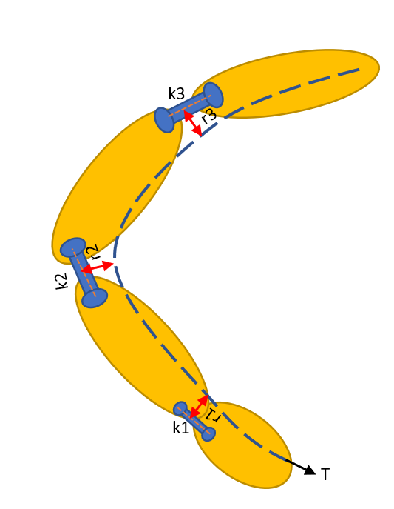
Methodology - Dynamics
r_{a}Δθ_{a} = J_{a}Δθ {Kinematic constraint}*
KΔθ + J_{a}^{T}f_{a} = 0 {Quasi static equilibrium constraint}*
where,
J_{a} = [r₁, r₂, r₃]
K = [[K₁,0,0],[0,K₂,0],[0,0,K₃]]
Δθ = [Δθ₁,Δθ₂,Δθ₃]^{T}
Using, K₁ = r₁ = r₂ = r₃ = r_{a} = 1, solve to get:
K₂, K₃, T(f_{a}), Δθ_{a}
*(Davidson & Mo, 2015)
Notes:
These constraint equations are used to calculate stiffness and tension values at equilibrium for each possible configuration

Slide 8
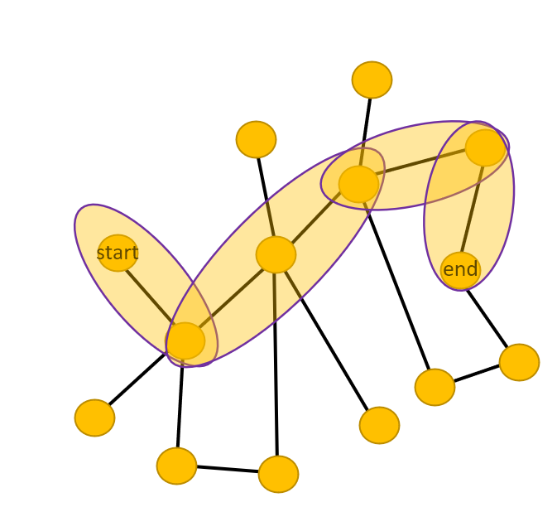
Methodology - Graph Search
Cartesian distance between configurations as edge length(cost function)
(Required objective function)
A* search algorithm for optimal path
Heuristic: Cartesian distance between current and end configuration
Notes:
Then for the graph search, each possible configuration along with the information of stiffness and tension to maintain that configuration at equilibrium is considered a separate node. Nodes are connected when either stiffness or tension value is equal amongst the nodes. The edge length connecting the nodes is calculated according to the objective function. Here the objective was to minimize actual path length travelled by end point. A* search algorithm is then used to find an optimal path where heuristic was the cartesian distance between current node and end node.

Slide 9
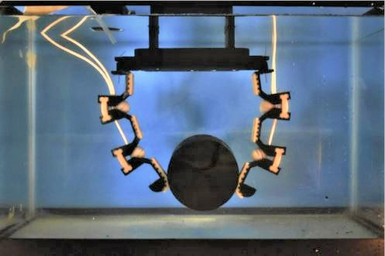
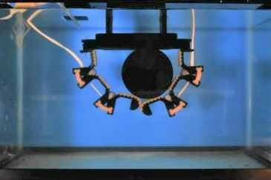
Experiments
Pinch Grasp
Wrap Grasp
Grasp Type | Start Configuration | End Configuration
Pinch | (1,1,1) | (90°,10°,5°)
Wrap | (1,1,1) | (90°,15°,30°)
Notes:
For experiments we generated optimal paths for the end configurations of two of grasp types (i.e. wrap and pinch).

Slide 10
Simulations (Part 1)
Notes:
These are intermediate points that were generated form the optimal path.
This is mostly linear for the end point phases. Travels in almost straight path

Slide 11
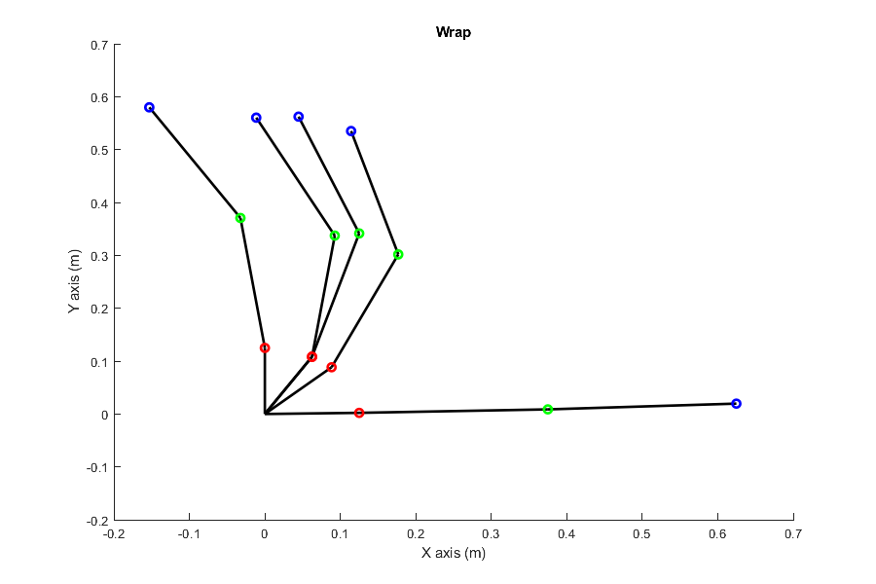
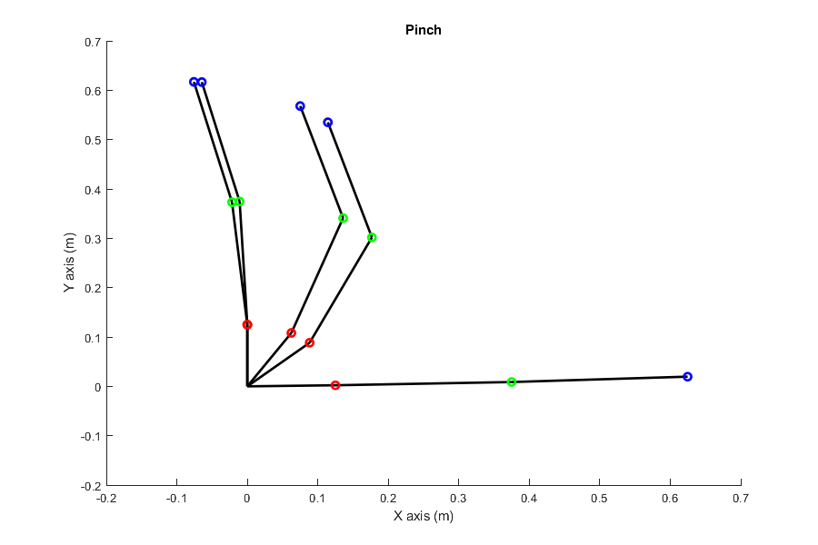
Simulations (Part 2)
Notes:
This is just shows all the frames put together with its respective graph

Slide 12
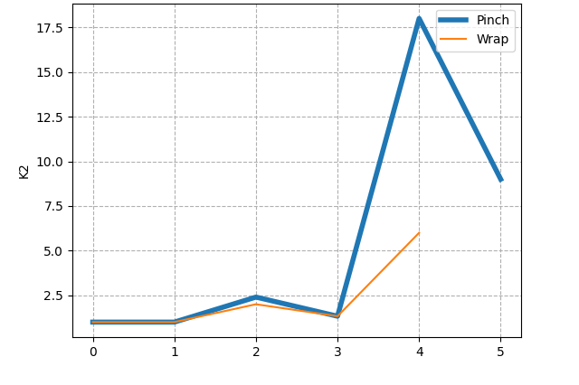
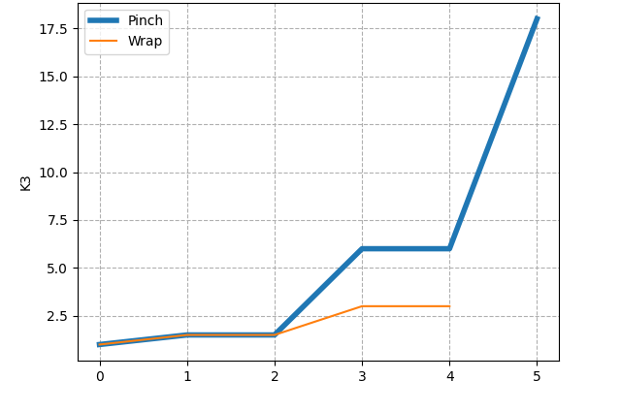
Results
Proximal Joint Stiffness
Distal Joint Stiffness
Notes:
The results show optimal paths for both proximal and distal joint stiffness for the two types of grasp primitives (i.e pinch and wrap) which consistent with the general idea that for a pinch grasp stiffer distal joint.

Slide 13
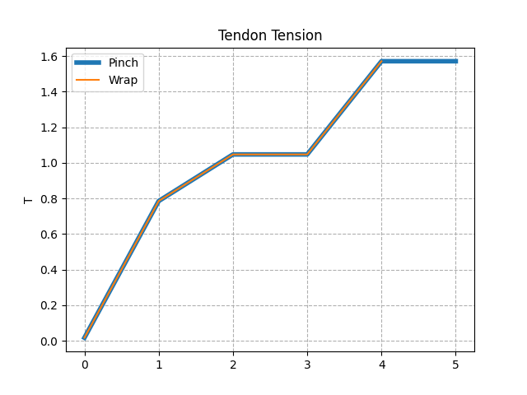
Results
Notes:
Additionally this graph shows that the tendon tension is the similar for both grasp primitives.

Slide 14
Conclusion/Discussion
We calculate the control inputs (K₂,K₃ & T) at these states:
𝛉1: 1-90° ,𝛉2 and 𝛉3: 1-45° (with intervals of 5°)
Increase the granularity for a smoother path
Notes:
In the graphs we saw, the paths were not as smooth because our interval values were set to 5 degrees. The path will become smoother by increasing the granularity.

Slide 15
Future Work
Change edge length according to the required objective function
Implement time scaling
Notes:
Additionally If we have knowledge of actuators, we can substitute actuator effort from one configuration to another as edge length between two nodes to generate energy optimal path.
For our future work we plan to change the len…
Additionally if we have knowledge ab….
Last two points we will implement in our own research in adding time scaling as well as creating the actual controller for the system we presented earlier.
Right now we have done the preliminary steps so we will follow through with some additional modifications to make a controller for the variable joint stiffness hand we are working with
The way we calculated dynamics that is quiasi static (w/out gravity) if we have gravity we can include in dynamics equation
Contact dynamics (include)

Slide 16

Questions ?

